Slide 1
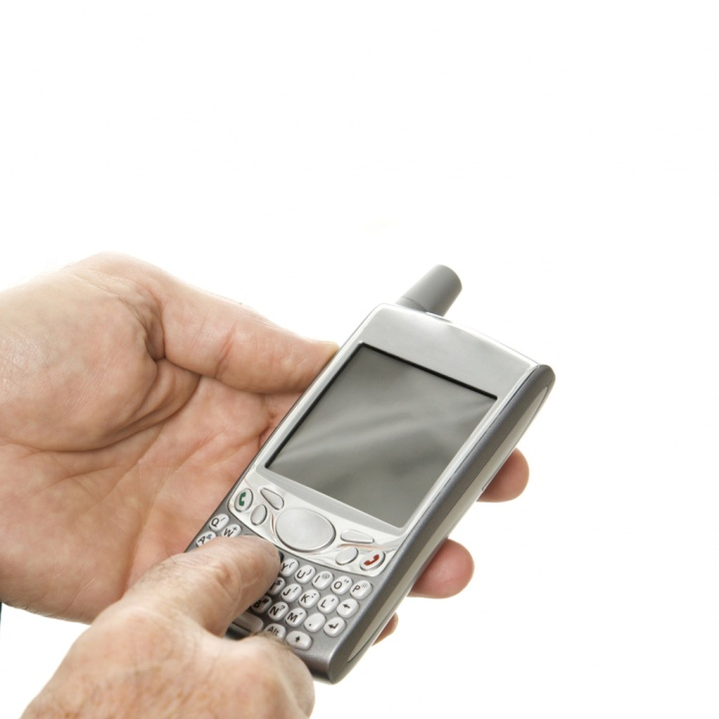
Develop A Communication Plan

Slide 2
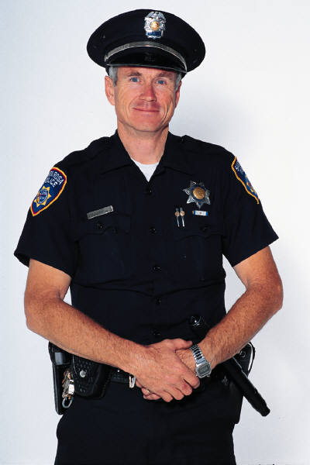
Family Communication Plan
Know who to contact
  Family members and Relatives
  Police
  Fire
  Hospital
  Red Cross
  FEMA
  Health Department

Slide 3

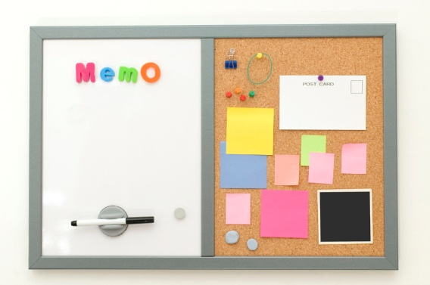
Family Communication Plan
Designate
  A safe meeting place
  Location for the Emergency Food Supply Kit
    Up to date identification
    Up to date medical information
  Area to post contact information sheet

Slide 4
Shelter
Locations
  Examples of shelter locations
    American Red Cross
    Community Centers
    Schools
Route to shelter
  Know different routes
Pet friendly shelters if you have pets

Slide 5

Work Together
What has been done to ensure your safety at:
  Schools
  Work
Create a Safe Environment
  Work with neighbors
  Conduct community emergency drills

Slide 6
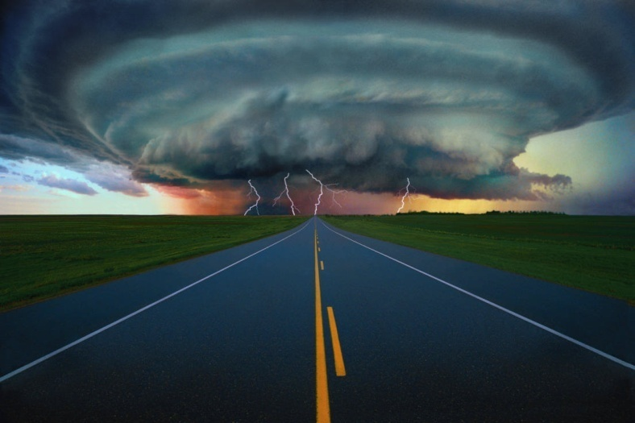
Be Ready To Take Action!
Keep an emergency plan with your emergency food kit!
If disaster strikes, you and your family will be prepared.

Slide 7
Follow all instructions provided on the TV and radio or in the newspaper.
Remember, your safety is top priority during any disaster.

Slide 8
Conclusion
Post an emergency contact information list in a convenient location.
Designate a safe meeting place.
Know locations of shelters in your area.
Create a safe environment in your community.
Follow all provided instructions.

